Slide 1
Ryzen 5 3600 Microprocessor
Manufactured by AMD
Andrew Cook
Anil Erturk

Slide 2


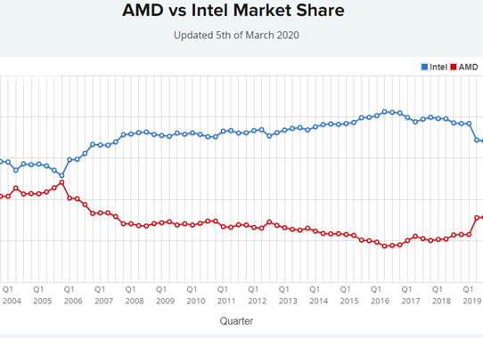

Why AMD Ryzen 5 3600
z
Recent developments in CPU industry
Market share history of AMD and Intel
Comeback of AMD
What caused fall and rise of AMD

Slide 3
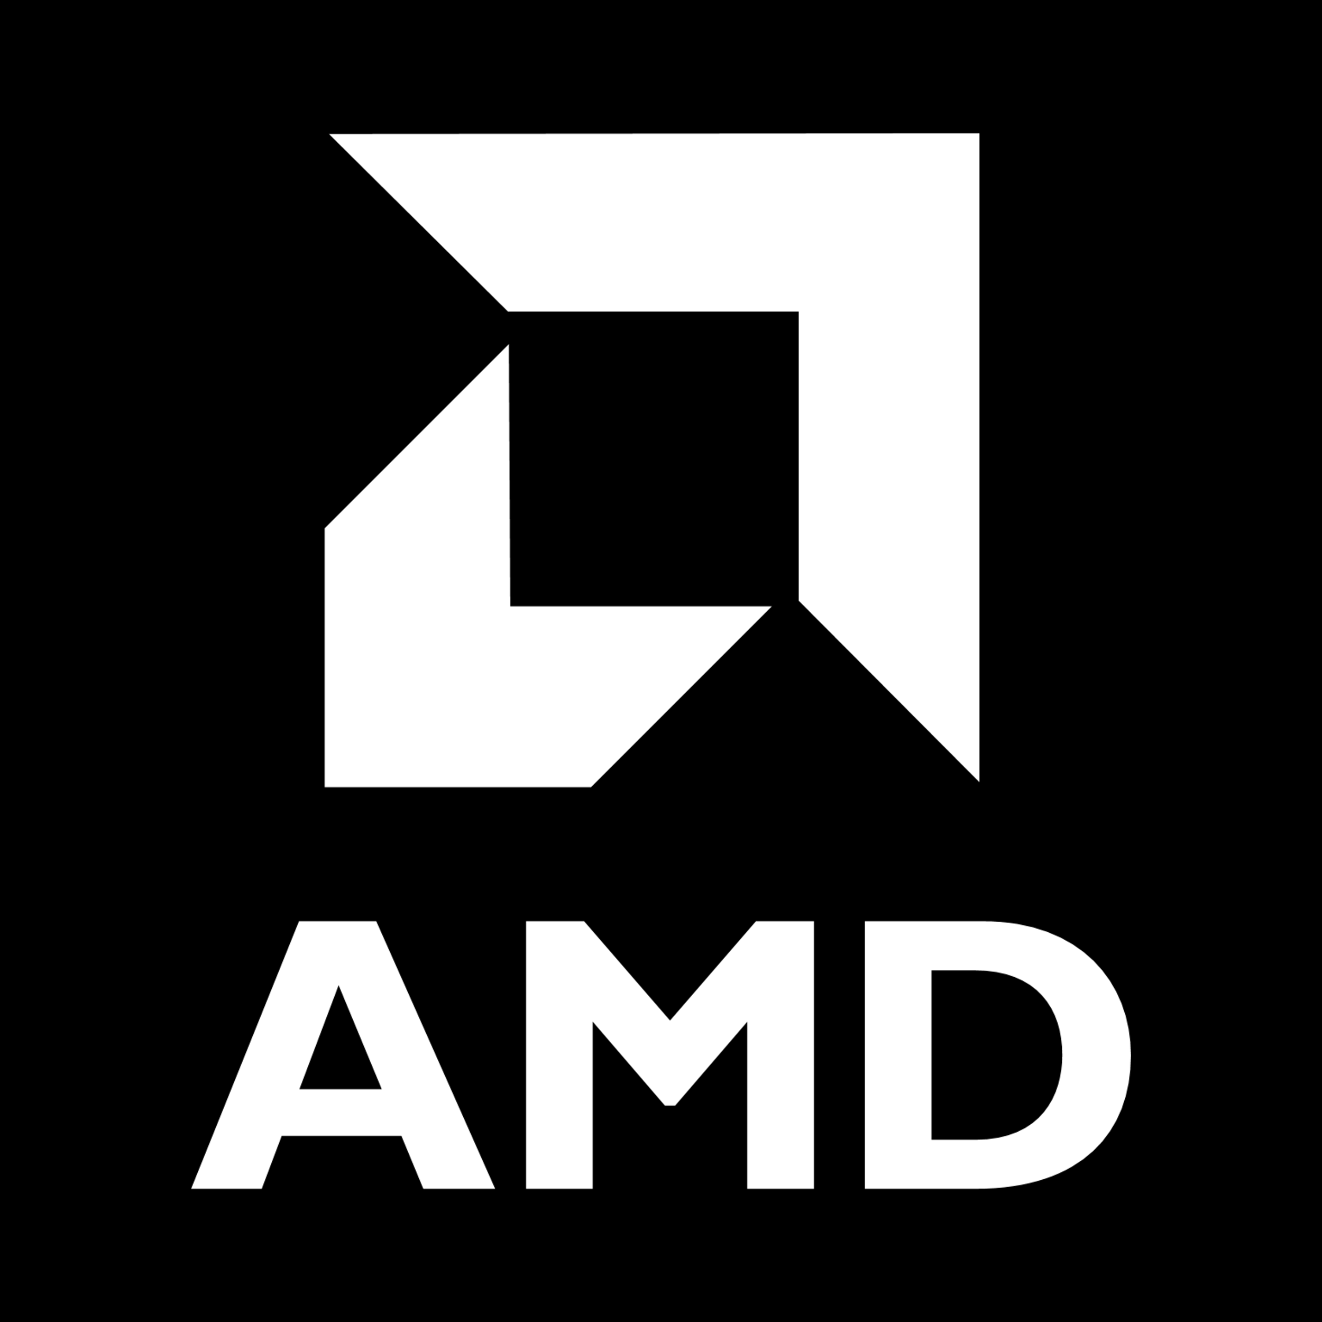
AMD
z
-AMD (Advanced Micro Devices)
-American multinational semiconductor company
-Initially manufactured its own processors, later outsourced to places where labor is cheaper, known as going “fabless”.

Slide 4
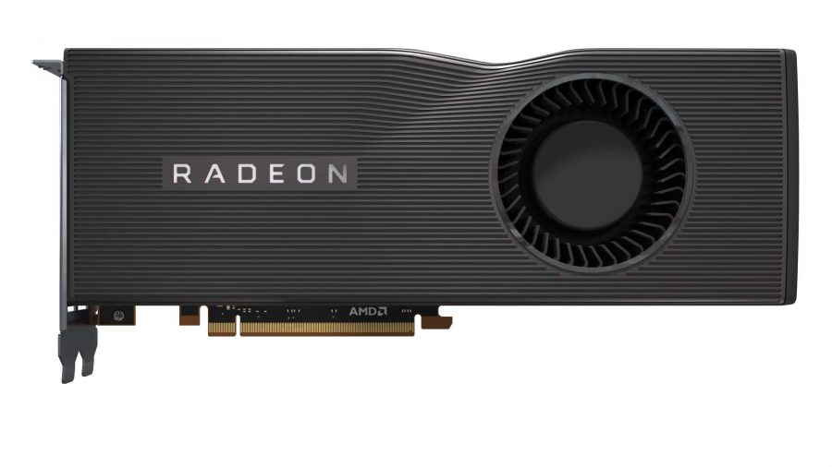
AMD
z
Microprocessors, motherboard chipsets, embedded processors and graphics processors.
Second-largest supplier in the market for x86-based microprocessors.
AMD and Nvidia has a duopoly in the discrete graphics processing unit (GPU) market.

Slide 5
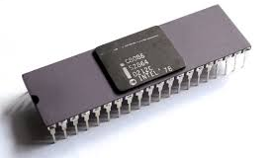
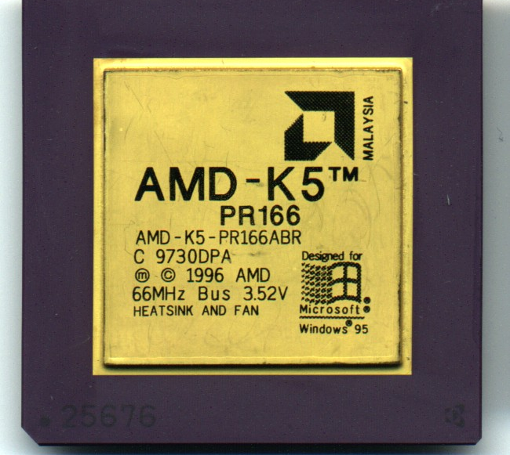
x86
z
Intel introduced first x86 processor in 1978 with 8086 and 8088.
AMD's first in-house x86 processor was the K5 in 1996.

Slide 6
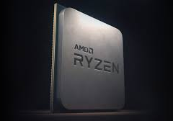
Ryzen
z
Brand of x86-64 microprocessors for desktop, mobile and embedded platforms based on the Zen, Zen+ and Zen 2 microarchitectures.
Ryzen consists of CPUs and APUs.

Slide 7
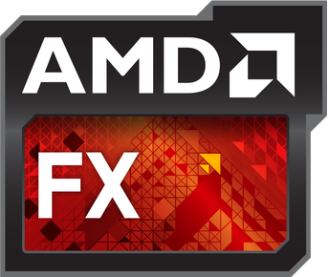
Ryzen
z
FX processors based on the Bulldozer architecture couldn’t compete with Intel's core series.
Ryzen was created from ground up and allowed AMD to return to the desktop CPU market.

Slide 8
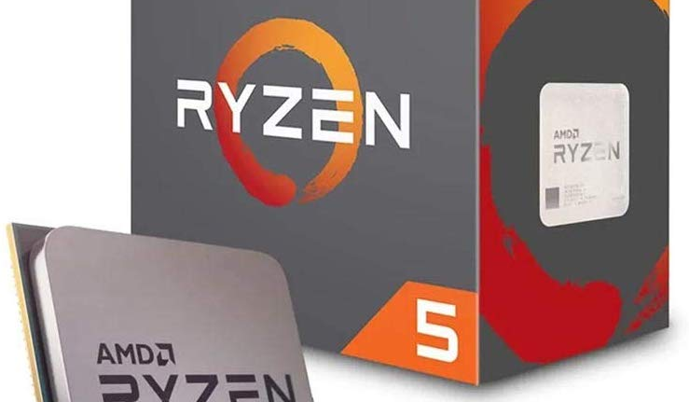
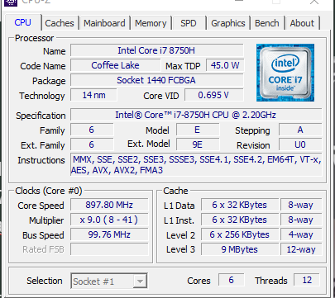
Ryzen 3-5-7-9-Threadripper, Epyc
z
Ryzen lineup includes Ryzen 3, Ryzen 5, Ryzen 7, Ryzen 9, and Ryzen Threadripper with up to 64 cores.
All consumer Ryzens have an unlocked multiplier and all except Ryzen 3 support Simultaneous Multithreading (SMT)

Slide 9
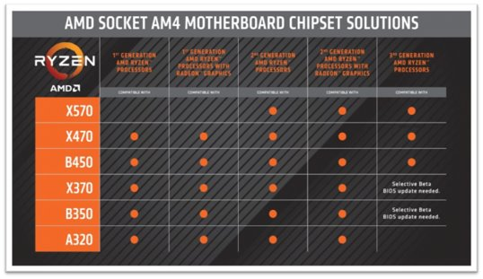
Motherboard compatibility of AM4 CPUs

Slide 10
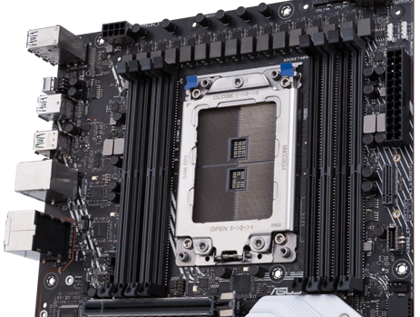
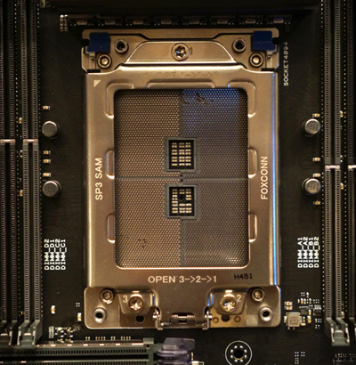
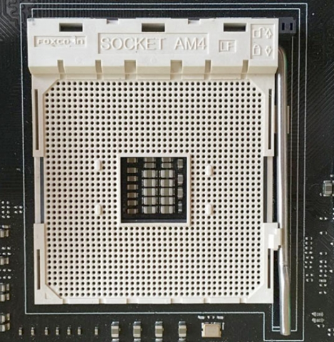
Sockets
z
AM4 – All three generations of Ryzen 3, 5, 7, and 9 uses AM4.
Socket sTRX4 is the direct successor to Socket TR4 used in the first and second generation Ryzen Threadripper products. It is physically identical to, but electrically incompatible with TR4.
TR4 and sTRX4 support more memory channels and PCIe lanes.

Slide 11
Ryzen General Info
z
Released in 2017.
Produced by TSMC and GlobalFoundries.
Performance 3-4.7 GHz clock rate

Slide 12
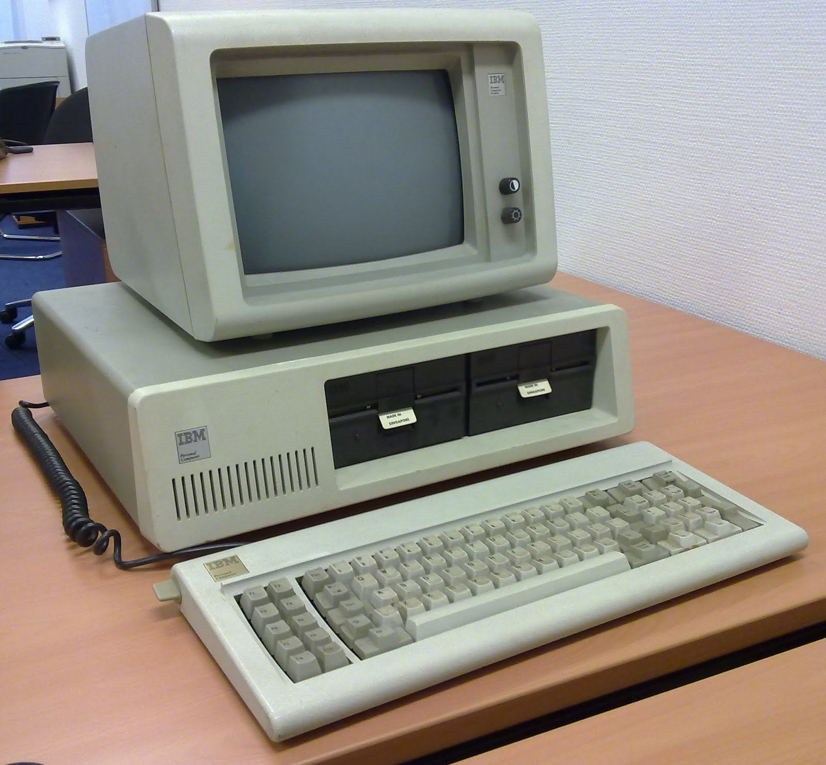
Architecture
Process: 7nm to 14nm
Instruction set: AMD64/x86-64, MMX(+), SSE1, SSE2, SSE3, SSSE3, SSE4a, SSE4.1, SSE4.2, AES, CLMUL, AVX, AVX2, FMA3, CVT16/F16C, ABM, BMI1, BMI2, SHA

Slide 13
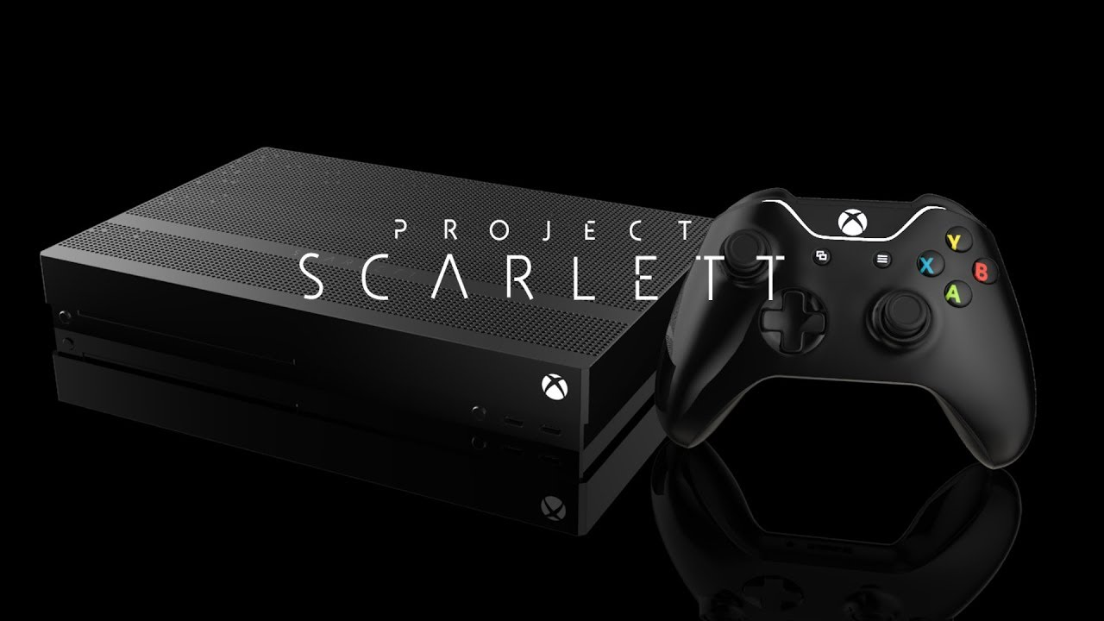
Zen 2
Zen (1), Zen 2, Zen 3 (not released).
7 nanometer design.
12-core, 24 thread.
Half the cost of Intel's HEDT chip.
New Project Scarlett (Xbox)

Slide 14
Physical design
Transistors: 4.8 billion
Cores: Up to 64 cores
Threads: 128

Slide 15
Ryzen 5
Ryzen 5 is the family of mid-range performance 64 bit quad and hexa-core x86 microprocessors of Ryzen lineup.
Competitive performance at lower prices to competes with Intel
Ryzen 5 CPUs have same features but with fewer cores than Ryzen 7.

Slide 16
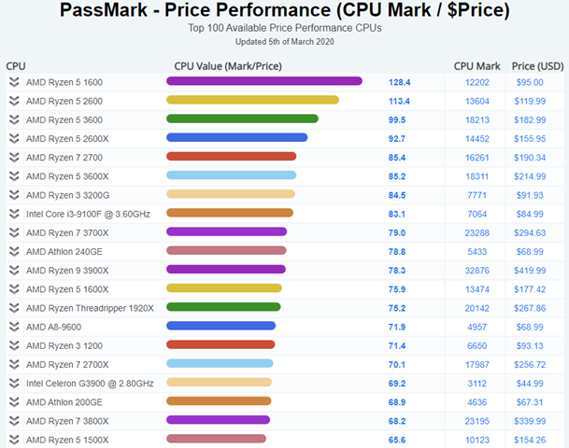
Ryzen 5 3600

Slide 17
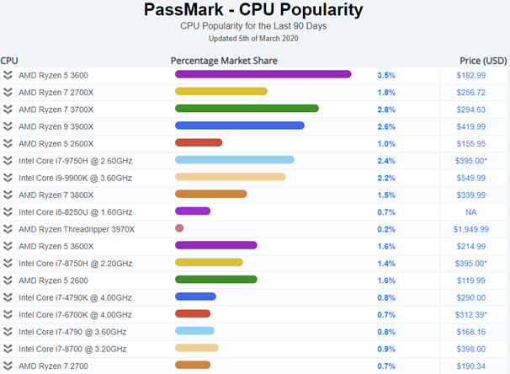
Ryzen 5 3600

Slide 18
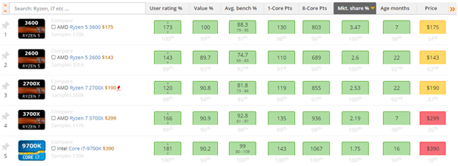
Ryzen 5 3600

Slide 19
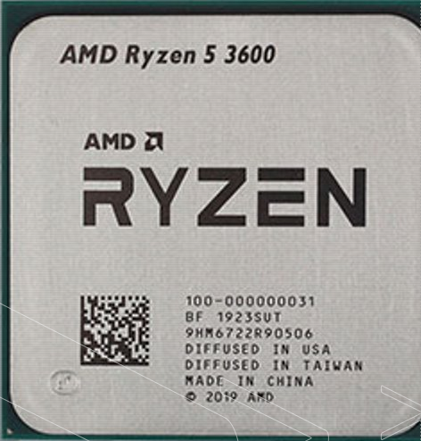
Ryzen 5 3600
Ryzen 5 3600 is a hexa-core(6 core) 12 thread high end performance x86-64 desktop microprocessor launched by AMD in 2019 with a launch price of $199 which is $175 as of Q1 2020.
Manufactured by TSMC’s 7nm process based on the Zen 2 microarchitecture,
it operates at 3.6 Ghz with a TDP of 65 Watt and a boost frequency of up to 4.2 Ghz.

Slide 20
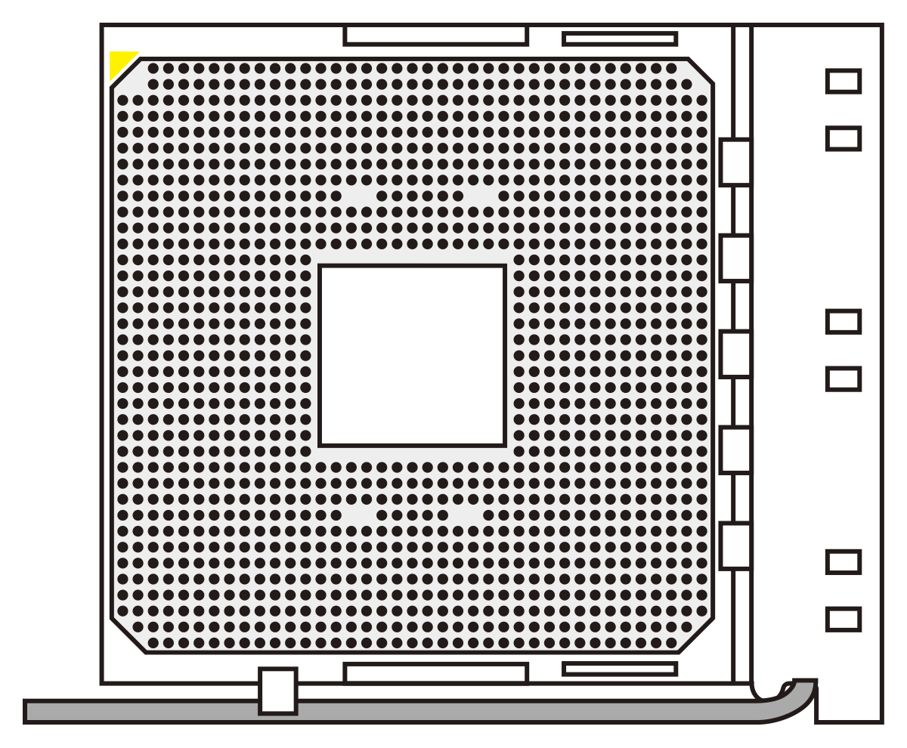
Ryzen 5 3600
Uses B0 core stepping(CPU version).
Uses MCP(Multi-chip module). Has 2 dies.
Max SMP(Symmetric multiprocessing) is 1-Way (Uniprocessor). This processor is meant to function as a uniprocessor. This means that a single CPU is used to complete tasks.
Pin count is 1331, socket is AM4.

Slide 21
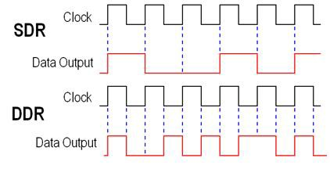
Ryzen 5 3600
The L3 cache (SRAM) is 32 MiB. L2 cache is 3 MiB. L1 cache is 384 KiB.
It has 2 memory channels. Supports up to 128 GiB of dual-channel DDR4 memory up to DDR-3200. Supports ECC(Error-correcting code) memory. Single channel bandwidth is 23.84 GiB/s. Double channel bandwidth is 47.68 GiB/s.

Slide 22
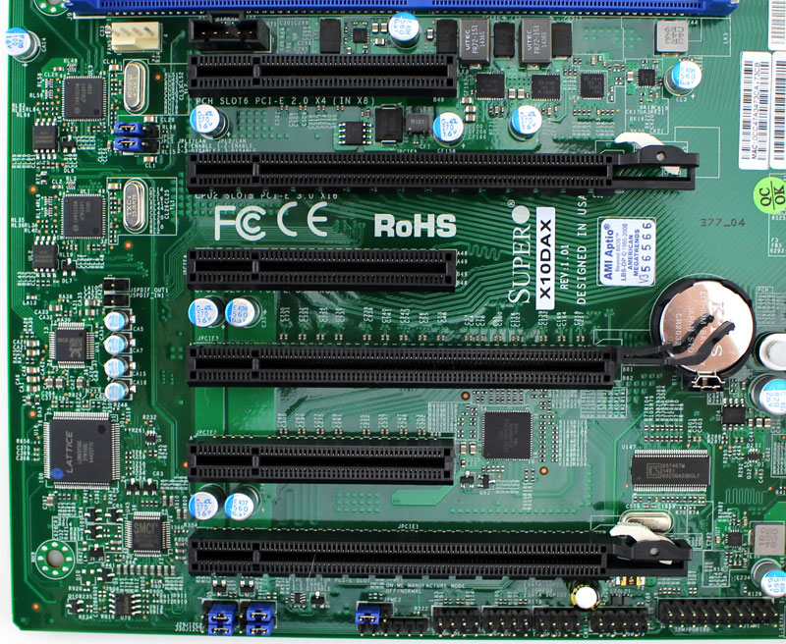
Ryzen 5 3600
In addition to the 4 PCIe(peripheral component interconnect express) lanes that are reserved for the chipset, the Ryzen 5 3600 has 16 lanes for a discrete graphics processor and 4 lanes for storage (NVMe or 2 ports SATA Express).
This processor has no integrated graphics.

Slide 23
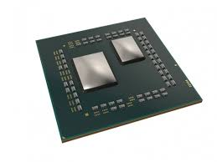
Chiplet Design
z
A chiplet is an independent unit that has been designed to work with other chiplets.
Historically the need to go with multiple chips was driven by fabrication limits.
As processes continued to enable higher integration, multiple dies were merged into single, more complex integrated circuits.

Slide 24
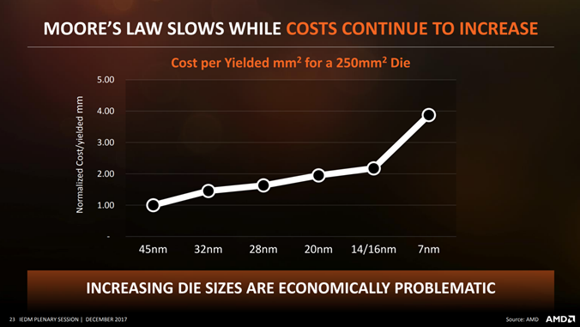
Cost of leading edge nodes
Due to the cost associated with leading-edge nodes, it became advantageous to, once again, de-integrate and break down a large die into smaller 'chiplets' in order to improve yield and binning.
z

Slide 25
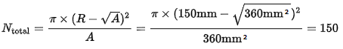
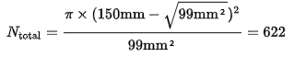
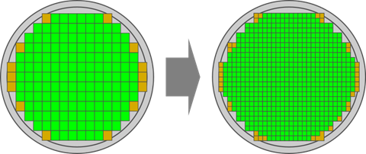
Wafer yield and cost
z
Consider a D0 of 0.1 defects per cm². Now, consider a medium-sized die 18 mm x 20 mm (360 mm²). On a standard 300-millimiter wafer size, up to 150 dies can be fabricated.
Splitting up the same die into four chiplets - 9.5 mm x 10.5 mm (~99 mm²) results in 622 dies instead.

Slide 26
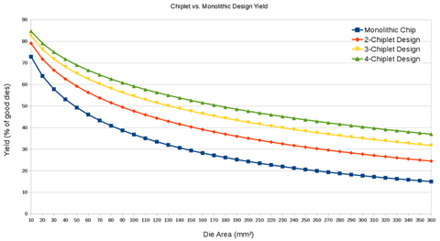
Wafer yield and cost
Below is a plot of percent of yield per wafer for a die of various sizes versus the same die consisting of two, three, and four chiplets. Note that an additional 10% overhead for the cross-die communication has been added to the chiplet-based design.
z

Slide 27
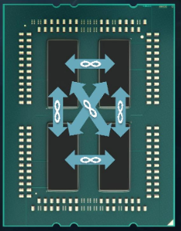
Infinity Fabric
z
Chiplet design is cheaper but the chiplets need to be connected. AMD uses Infinity Fabric as a solution to this.
Infinity Fabric (IF) is a proprietary system interconnect architecture that facilitates data and control transmission across all linked components.
This architecture is utilized by AMD's recent microarchitectures for both CPU (i.e., Zen) and graphics (e.g., Vega), and any other additional accelerators they might add in the future.

Slide 28
Precision Boost 2
z
Precision Boost 2 is a performance-maximizing technology available in all AMD Ryzen and Ryzen Threadripper 2000 Series processors or newer.
This technology can improve PC’s performance by raising clockspeeds, which makes the processor—and applications—run faster.
Best of all, Precision Boost 2 is entirely automatic: AMD’s intelligent processors have a sophisticated set of sensors designed to analyze conditions inside the PC and boost the CPU as often as possible.

Slide 29
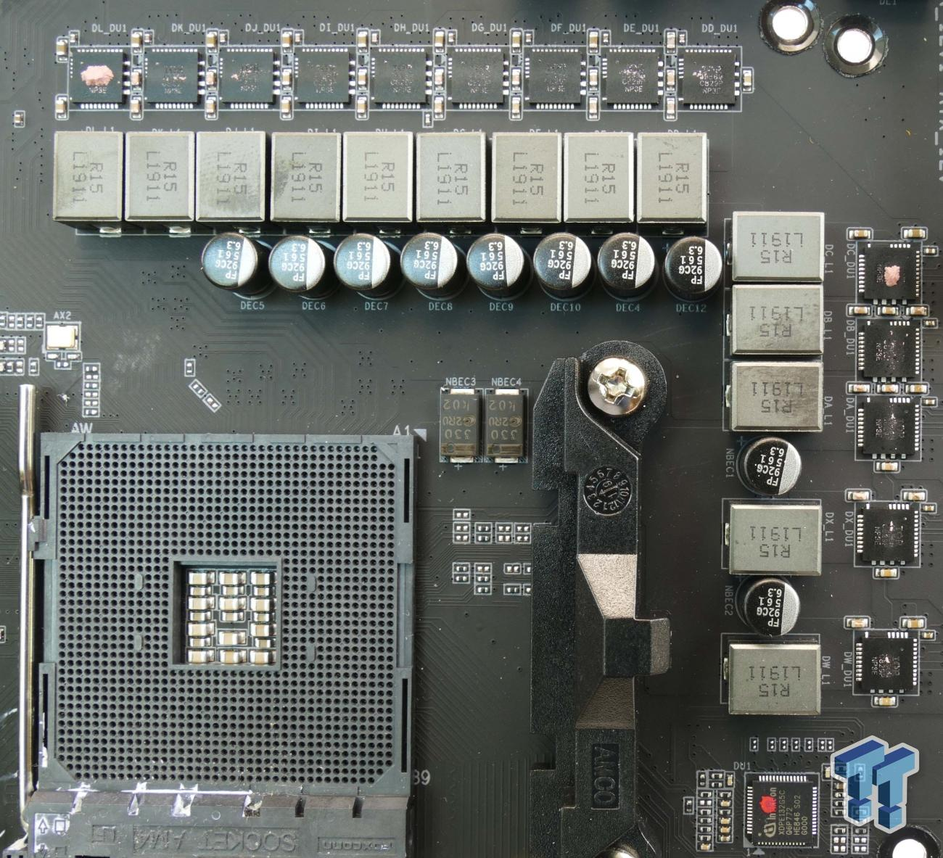
Precision Boost Overdrive
z
Available with 3rd gen Ryzen 5 or above CPUs, when coupled with AMD x570 motherboards. Around the CPU socket, under the heatsinks, there are VRMs. They supply power from the power supply, through the motherboard to the CPU socket.
Motherboards tend to have more VRMs than what minimum specification calls for. With precision boost overdrive, the CPU and the socket can communicate with the motherboard to learn how much extra capacity is there. Motherboard might provide extra power to the CPU, which allows the CPU to run at a higher clock speed. Another important thing is the higher clock speed can be sustained for longer because of the higher power supply.

